Slide 1
VIRTUAL ASSISTANT
PROJECT GUIDE :- Prof. Rupinder Kaur
TEAM MEMBERS
Jaspreet Singh (2001466)
Jugraj Singh (2001467)
Khushboo Rana (2001468)
MANINDER SINGH (2001469)

Slide 2
Introduction To Project
In this modern era, day to day life became smarter and interlinked with technology. We already know some voice assistance like GOOGLE, Siri. etc. Now in our voice assistance system, it can act as a basic medical prescriber, daily schedule reminder, note writer, calculator and a search tool. This project works on voice input and give output through voice and displays the text on the screen. The main agenda of our voice assistance makes people smart and give instant and computed results. The voice assistance takes the voice input through our microphone (Bluetooth and wired microphone) and it converts our voice into computer understandable language gives the required solutions and answers which are asked by the user. This assistance connects with the world wide web to provide results that the user has questioned. Natural Language Processing algorithm helps computer machines to engage in communication using natural human language in many forms.

Slide 3
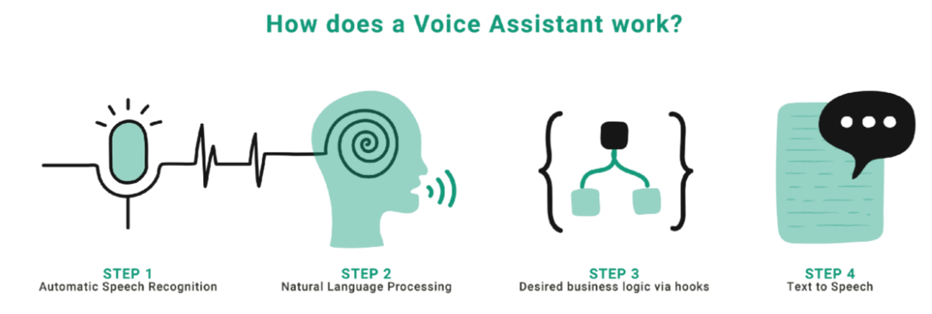
Related Work
The technologies that are used to create intelligent systems of interaction with a human by his natural language. The main technologies are voice activation, automatic speech recognition, Teach-To-Speech, voice biometrics, dialogue manager, natural language understanding and named entity recognition.
Natural language processing: NLP algorithms are typically based on machine learning algorithms. Instead of hand-coding large sets of rules, NLP can rely on machine learning to automatically learn these rules by analyzing a set of examples (i.e. a large corpus, like a book, down to a collection of sentences), and making a statistical inference

Slide 4
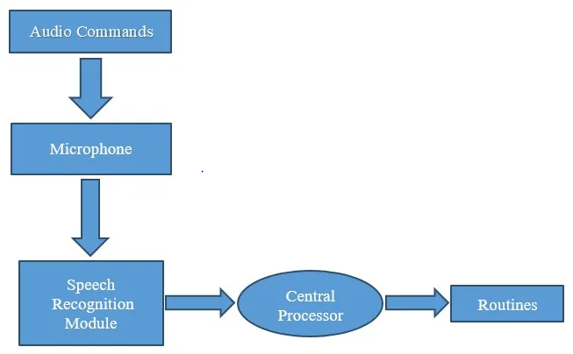
Proposed Plan Of Work

Slide 5
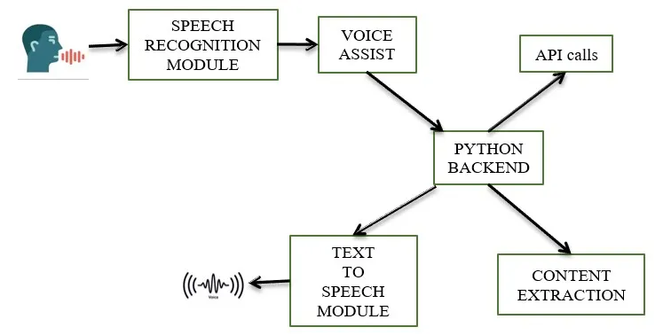
Methodology of Virtual Assistant Using Python

Slide 6
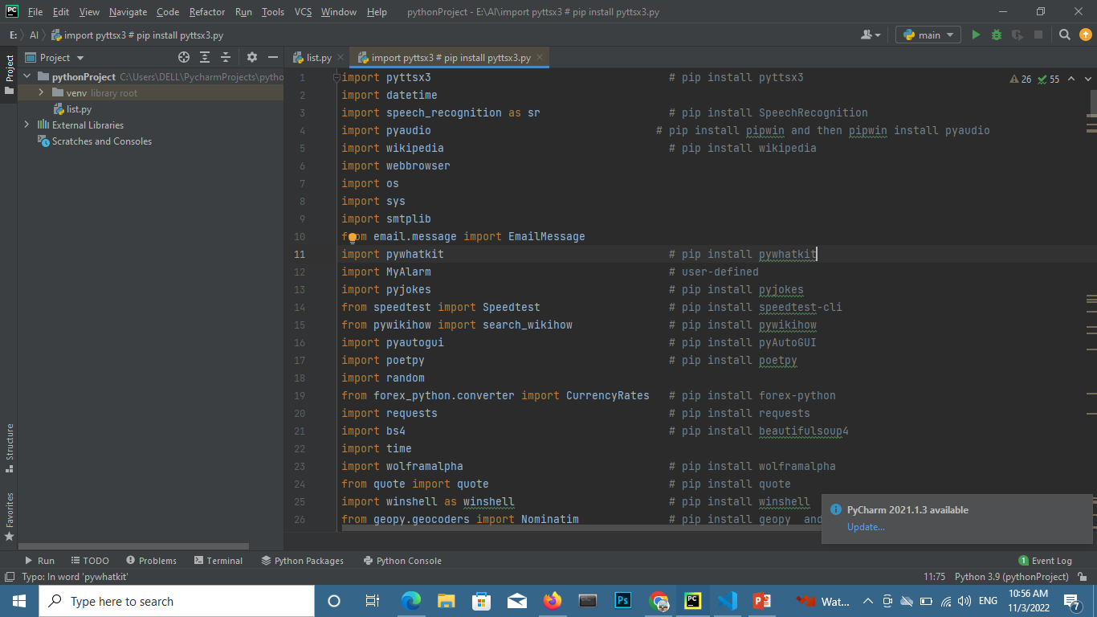
SCREENSHOTS

Slide 7
Methodology
Speech Recognition module :
The system uses Google’s online speech recognition system for converting speech input to text. The speech input Users can obtain texts from the special corpora organized on the computer network server at the information center from the microphone is temporarily stored in the system which is then sent to Google cloud for speech recognition.
Python Backend :
The python backend gets the output from the speech recognition module and then identifies whether the command or the speech output is an API Call and Context Extraction. The output is then sent back to the python backend to give the required output to the user.

Slide 8
Future scope:
The next step will be to remove as much hardware as possible. With the ingenuity of the VA present in the clouds, being pulled in, and pushing its way into our lives with many devices in our bodies and our offices, homes, and cars.
Your VA will always tell you about suggestions and take orders, and you will know more about yourself than you know yourself. We can expect this device to be installed and permanent.

Slide 9
WORK DONE TILL NOW
Coding of Virtual assistant Is almost done.
Currently, we are facing error in libraries such as Pyaudio, MyAlarm.
Queries or commands are written in our code.
Interface of virtual assistant Is still pending.
Fun talks

Slide 10
Conclusion
The project is built using open source software modules with PyCharm community backing which can accommodate any updates shortly. The modular nature of this project makes it more flexible and easy to add additional features without disturbing current system functionalities.
It not only works on human commands but also give responses to the user based on the query being asked or the words spoken by the user such as opening tasks and operations. It is greeting the user the way the user feels more comfortable and feels free to interact with the voice assistant.

Slide 11
References
[1] R. Belvin, R. Burns, and C. Hein, “Development of the HRL route navigation dialogue system,” in Proceedings of ACL-HLT, 2001
[2] V. Zue, S. Seneff, J. R. Glass, J. Polifroni, C. Pao, T.J.Hazen,and L.Hetherington, “JUPITER: A Telephone Based Conversational Interface for Weather Information,” IEEE Transactions on Speech and Audio Processing, vol. 8, no. 1, pp. 85–96, 2000.
[3] M. Kolss, D. Bernreuther, M. Paulik, S. St¨ucker, S. Vogel, and A. Waibel, “Open Domain Speech Recognition & Translation: Lectures and Speeches,” in Proceedings of ICASSP, 2006.
[4] D. R. S. Caon, T. Simonnet, P. Sendorek, J. Boudy, and G. Chollet, “vAssist: The Virtual Interactive Assistant for Daily Homer-Care,” in Proceedings of pHealth, 2011.
[5] Crevier, D. (1993). AI: The Tumultuous Search for Artificial Intelligence. New York, NY: Basic Books, ISBN 0-465-02997-3.
[6] Sadun, E., &Sande, S. (2014). Talking to Siri: Mastering the Language of Apple’s Intelligent Assistant.

Slide 12
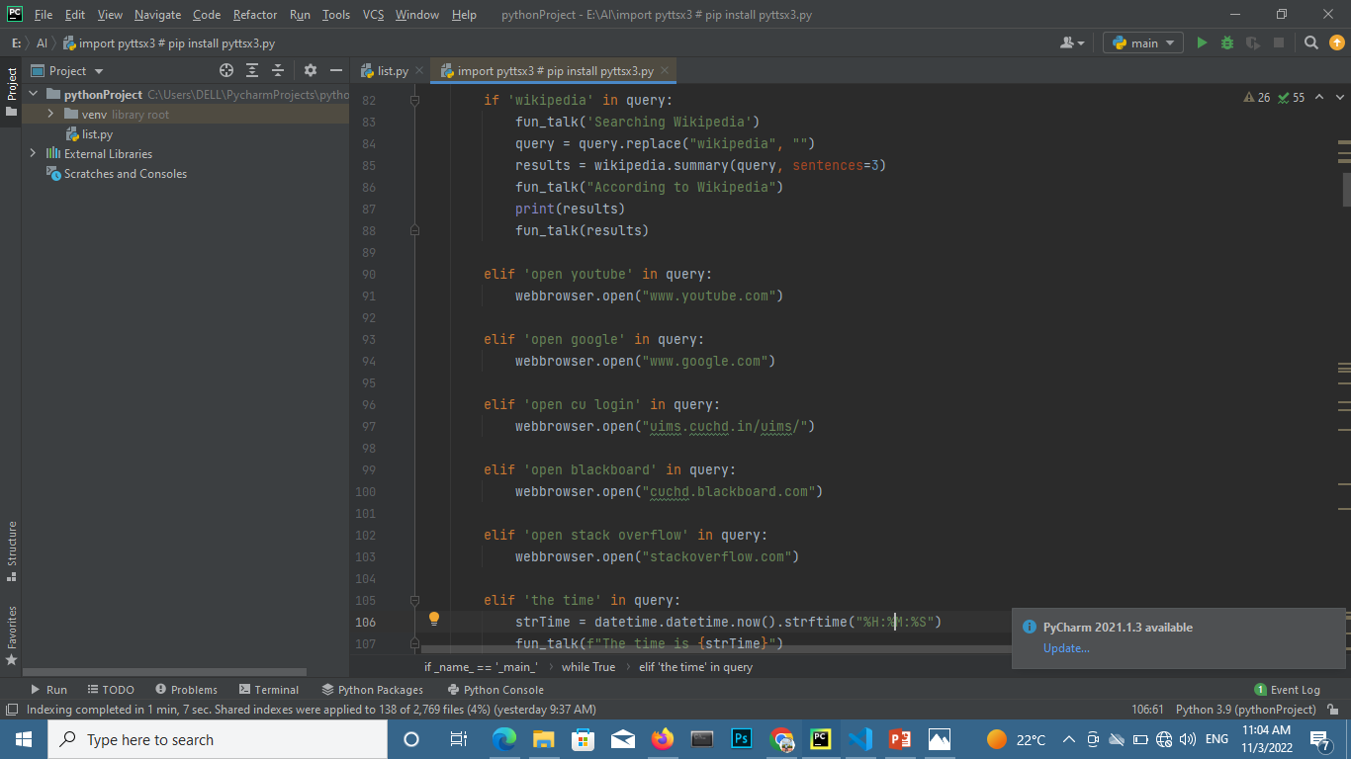
Commands:

Slide 13
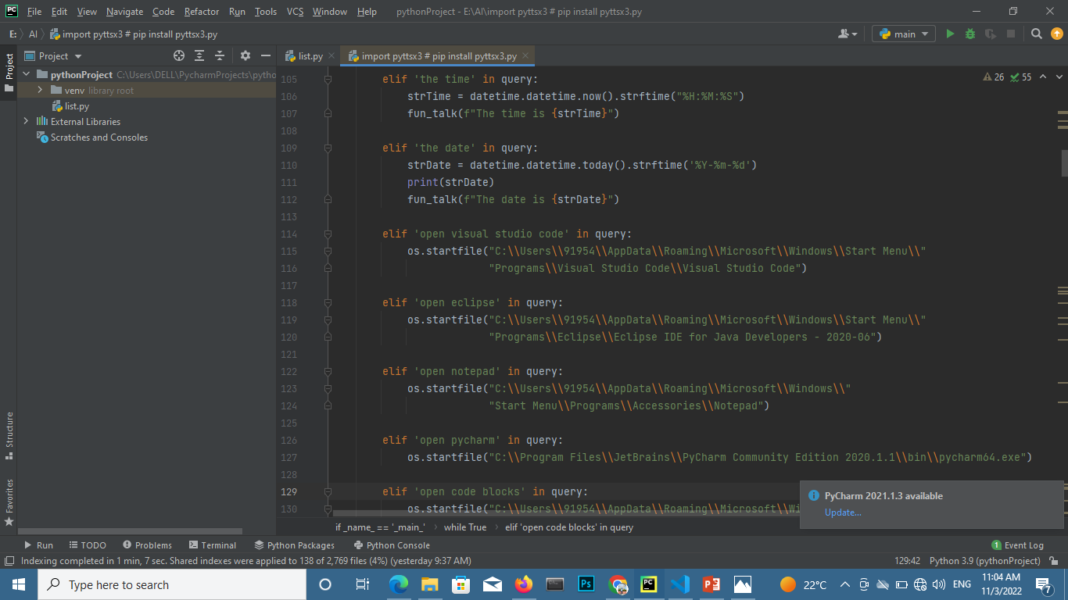
Commands:

Slide 14
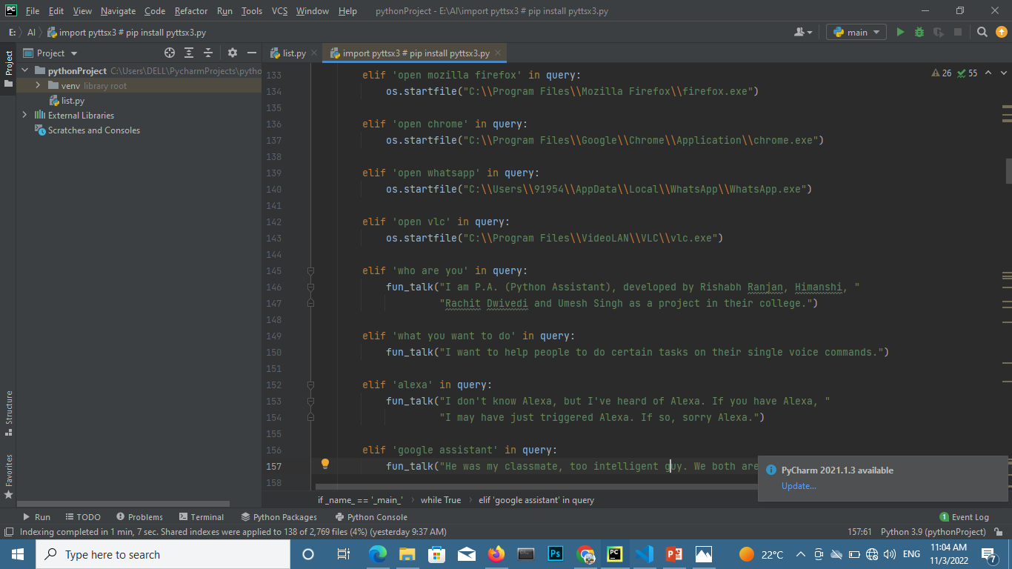
Different

Slide 15
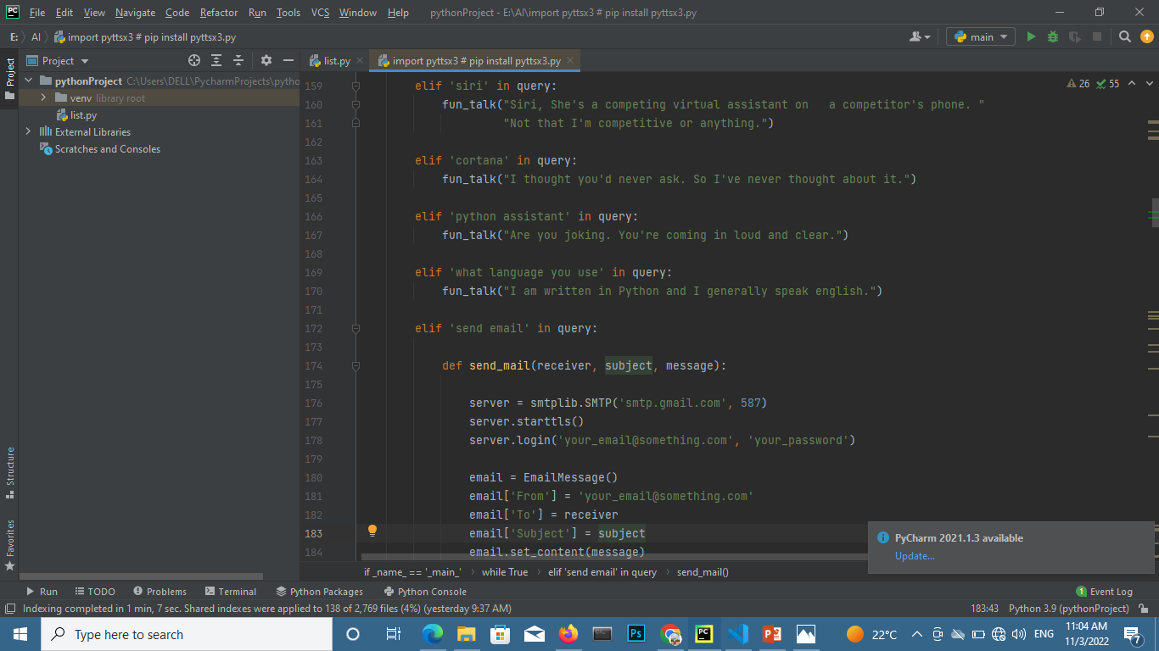

Slide 16
Thank you

